Slide 1
Experiment in Compiler Construction Scanner design

Slide 2
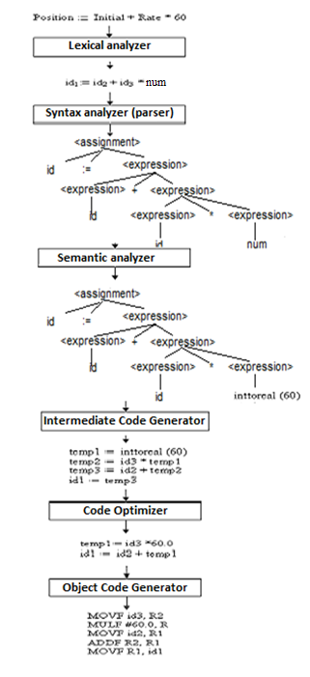
Translation of a statement

Slide 3
What is a scanner?
The compiler’s component/module that perform the job of lexical analysis (scanning) is called scanner.
Compiler’s first phase
_{Lexical}
_{Analysis}
_{Syntax}
_{Analysis}
_{Semantic}
_{Analysis}
_{Code}
_{Generation}

Slide 4
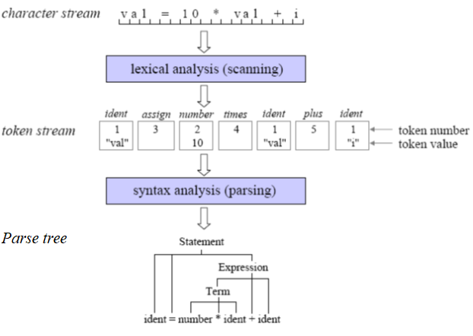
What is a scanner?

Slide 5
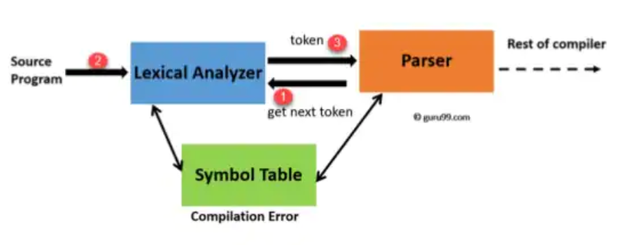
Scanner – Parser interaction

Slide 6
Tasks of a scanner
Skip meaningless characters: blank, tab, new line character, comment.
Recognize illegal character
Return error message
Recognize different types of token
identifier
keyword
number
special symbols
...
Pass recognized tokens to the parser (the module that perform the job of syntatic analysis)
Note: skip leading 0s, spaces, atoi to change string to values, ident max 15, must read every character before deciding token type or error

Slide 7
Lexical rules of KPL
Only use unsigned integer
The KPL identifier is made with a combination of lowercase or uppercase letters, digits. An identifier must start with a letter. The length <=15.
Only allows character constants. A character constant is enclosed with a pair of single quote marks. ‘’
The language do not use string constant.
- is use for subtraction only. The language does not allow unary minus and negative numbers
The relational operator “not equal to” is represented by !=

Slide 8
KPL’s alphabet
Letter: a b c … x y z
A B C … X Y Z
Digit: 0 1 2 … 8 9
Special character:
+ - * /
> < ! =
[space] ,(comma) . : ; ‘ _
( )

Slide 9
KPL’s tokens
Keywords
PROGRAM, CONST, TYPE, VAR, PROCEDURE, FUNCTION, BEGIN, END, ARRAY, OF, INTEGER, CHAR, CALL, IF, THEN, ELSE, WHILE, DO, FOR, TO
Operators
:= (assign)
+ (addition), - (subtraction), * (multiplication), / (division)
= (comparison of equality), != (comparison of difference), > (comparison of greaterness), < (comparison of lessness), >= (comparison of greaterness or equality), <= (comparison of lessness or equality)

Slide 10
KPL’s tokens
Special characters
; (semicolon), . (period), : (colon), , (comma), ( (left parenthesis), ) (right parenthesis), ‘ (singlequote)
Also
(. and .) to mark the index of an array element
(* and *) to mark the comment
Others
identifier, number, illegal charater

Slide 11
Recognizing KPL’s tokens
All KPL’s tokens make up a regular language.
They can be described with regular grammar, regular expression
They can be recognized by a Deterministic Finite Automaton (DFA)
The scanner is a big DFA
This time, code by DFA

Slide 12
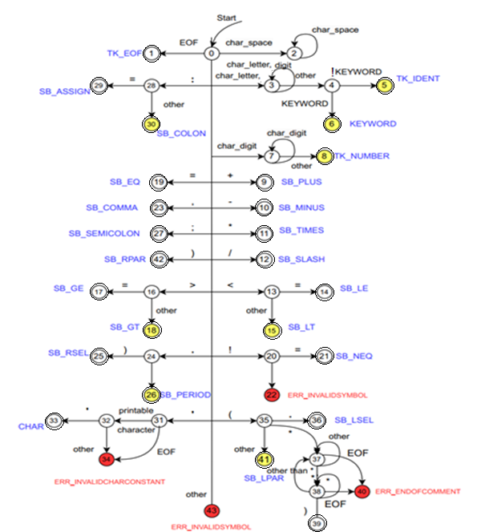

The scanner as a Deterministic Finite Automaton
After every recognized token, the scanner starts in state 0 again
If an illegal character is met, the scanner would change to the states 22 or 43 which tell the scanner to stop scanning and return error messages.
Notice the yellow states
Bắt đầu mở ngoặc + sao là chú thích
Neu toan 0 thi luu 0

Slide 13
KPL scanner - organization
# | Filename | Task
1 | Makefile | Project
2 | scanner.c | Main
3 | reader.h, reader.c | Read the source code
4 | charcode.h, charcode.c | Classify character
5 | token.h, token.c | Classify and recognize token, keywords
6 | error.h, error.c | Manage error types and messages
13

Slide 14
KPL scanner – reader
// Read a character from input stream
int readChar(void);
// Open input stream
int openInputStream(char *fileName);
// Close input stream
void closeInputStream(void);
// Current line number and column number
int lineNo, colNo;
// Current character
int currentChar;
14

Slide 15
KPL scanner – charcode
typedef enum {
CHAR_SPACE, // space
CHAR_LETTER, // character
CHAR_DIGIT, // digit
CHAR_PLUS, // ‘+’
CHAR_MINUS, // ‘-’
CHAR_TIMES, // ‘*’
CHAR_SLASH, // ‘/’
CHAR_LT, // ‘<‘
CHAR_GT, // ‘>‘
CHAR_EXCLAMATION, // ‘!’
CHAR_EQ, // ‘=‘
CHAR_COMMA, // ‘,’
CHAR_PERIOD, // ‘.’
CHAR_COLON, // ‘:’
CHAR_SEMICOLON, // ‘;’
CHAR_SINGLEQUOTE, // ‘\’’
CHAR_LPAR, // ‘(‘
CHAR_RPAR, // ‘)’
CHAR_UNKNOWN // invalid character
} CharCode;
15

Slide 16
KPL scanner – charcode
In charcode.c, we define charCodes array that associates every ASCII character with an unique predifined CharCode.
getc() function may return EOF (or -1) which is not an ASCII character.
16

Slide 17
KPL scanner – token
typedef enum {
TK_NONE, // Invalid token - Error
TK_IDENT, // Identifier token
TK_NUMBER, // Number token
TK_CHAR, // Character constant token
TK_EOF, // End of program token
// keywords
KW_PROGRAM, KW_CONST, KW_TYPE, KW_VAR,
KW_INTEGER, KW_CHAR, KW_ARRAY, KW_OF,
KW_FUNCTION, KW_PROCEDURE,
KW_BEGIN, KW_END, KW_CALL,
KW_IF, KW_THEN, KW_ELSE,
KW_WHILE, KW_DO, KW_FOR, KW_TO,
// Special character
SB_SEMICOLON, SB_COLON, SB_PERIOD, SB_COMMA,
SB_ASSIGN, SB_EQ, SB_NEQ, SB_LT, SB_LE, SB_GT, SB_GE,
SB_PLUS, SB_MINUS, SB_TIMES, SB_SLASH,
SB_LPAR, SB_RPAR, SB_LSEL, SB_RSEL
} TokenType;
17

Slide 18
KPL scanner – token
// Structure of a token
typedef struct {
char string[MAX_IDENT_LEN + 1];
int lineNo, colNo;
TokenType tokenType;
int value;
} Token;
// Check whether a string is a keyword or not
TokenType checkKeyword(char *string);
// Create new token, provided type of token and location
Token* makeToken(TokenType tokenType, int lineNo, int colNo);
18

Slide 19
KPL scanner – error management
// List of error may occur in lexical analysis
typedef enum {
ERR_ENDOFCOMMENT,
ERR_IDENTTOOLONG,
ERR_NUMBERTTOOLONG,
ERR_INVALIDCHARCONSTANT,
ERR_INVALIDSYMBOL
} ErrorCode;
// Error message
#define ERM_ENDOFCOMMENT "End of comment expected!"
#define ERM_IDENTTOOLONG "Identification too long!"
#define ERM_INVALIDCHARCONSTANT "Invalid const char!"
#define ERM_INVALIDSYMBOL "Invalid symbol!“
#define ERM_NUMBERTOOLONG "Value of integer number exceeds the range!"
19

Slide 20
KPL scanner – scanner.c
// Read the source code and show tokens
int scan(char *fileName) {
Token *token;
if (openInputStream(fileName) == IO_ERROR)
return IO_ERROR;
token = getToken();
while (token->tokenType != TK_EOF) {
printToken(token);
free(token);
token = getToken();
}
free(token);
closeInputStream();
return IO_SUCCESS;
}
20

Slide 21
KPL scanner – getToken function
Token* getToken(void)
{
Token *token;
switch(state)
{
case 0:
if (currentChar == EOF) state =1;
else
switch (charCodes[currentChar])
{
case CHAR_SPACE:
state =2;break;
case CHAR_LETTER:
ln=lineNo;
cn=colNo;
state =3;
break;
case CHAR_DIGIT:
state =7;
break;
case CHAR_PLUS:
state = 9;
break;
case … // more cases
21

Slide 22

KPL scanner – getToken function
case 0:
...
case CHAR_PLUS:
state =9;
break;
...
case 9:
readChar();
return makeToken(SB_PLUS, lineNo, colNo-1);
22

Slide 23
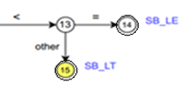
getToken: token composed of 2 characters
case 13:
readChar();
if (charCodes[currentChar] == CHAR_EQ) state = 14;
else state =15;
return getToken();
case 14:
readChar();
return makeToken(SB_LE, lineNo, colNo-1);
case 15:
return makeToken(SB_LT, lineNo, colNo-1);
23

Slide 24
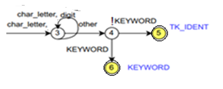
getToken: identifier and keyword recognition
An identifier can be composed of letters such as uppercase, lowercase letters, underscore, digits, but the starting character must be a letter.
Length of identifiers not over than 15 (MAX_IDENT_LENGTH)
Keywords are case insensitive?
How about identifiers?
Function checkKeyword is completed. Input, output?
24

Slide 25
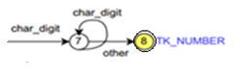
getToken: number recognition
typedef struct
{
char string[];
int lineNo, colNo;
TokenType tokenType;
int value;
} Token;
Convert string to integer with function atoi (stdlib.h)
Range 0÷ 2³¹-1 (Not more than 10 digits)
25

Slide 26
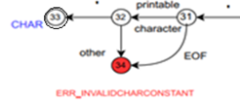
getToken: character constant recognition
case 31:
readChar();
if (currentChar == EOF)
state=34;
else
if(isprint(currentChar))
state =32;
else state =34;
return getToken();
case 32:
c= currentChar;
readChar();
if (charCodes[currentChar] == CHAR_SINGLEQUOTE)
state=33;
else
state =34;
return getToken();
case 33:
token = makeToken(TK_CHAR, lineNo, colNo-1);
token->string[0] =c;
token->string[1] ='\0';
readChar();
return token;
case 34:
error(ERR_INVALIDCHARCONSTANT, lineNo, colNo-2);
26

Slide 27
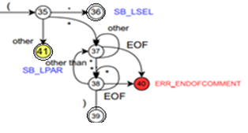
getToken: Skip comment
case 35: // tokens begin with lpar, skip comments
ln = lineNo;
cn = colNo;
readChar();
if (currentChar == EOF)
state=41;
else
switch (charCodes[currentChar])
{
case CHAR_PERIOD:
state =36;
break;
case CHAR_TIMES:
state =38;
break;
default:state =41;
}
return getToken();
27

Slide 28
Assignment
Complete following function in scanner.c
Token* getToken(void);
28

